Slide 1
CE 3372 water systems design
LeSSON 8: hydraulics of networks

Slide 2
outline
Network Hydraulic Principles
Constructing the Network System of Equations
Link-Node Continuity Partition
Link-Node Energy Partition
Adding Pumps

Slide 3
Network Hydraulic principles
Conservation of mass at a junction
ΣInflow – ΣOutflow = 0 (at a node)
Positive demand at a node is an outflow
Negative demand (injection into the network) is an inflow
One balance equation for each node
Head has a single value
Usually expressed as a pressure
Visualize as height of column of water in a piezometer at the junction
Pressure Head
Piezometer
Demand (External)
Inflow
Outflow

Slide 4
Network Hydraulic principles
Head Loss
Conservation of energy along a conduit
Modified Bernoulli’s equation
Include fitting losses if known
One energy equation for each conduit (link)
Pressure Head
Elevation Head
Datum

Slide 5
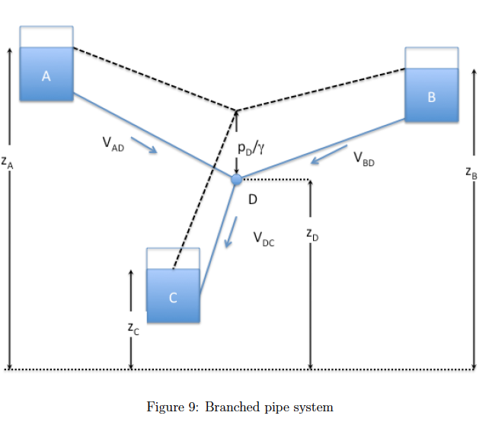
Branched System
Distribution networks are multi-path pipelines
One topological structure is branching
One node (continuity)
Three links (energy)
Four unknowns: V_{AD},V_{BD},V_{DC},H_{D}

Slide 6
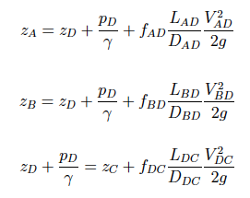
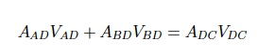
Branched System - analysis
Head loss in each pipe
Continuity at the node

Slide 7
Branched System
4 Equations, 4 unknowns
Non-linear so solve by
Newton-Raphson
Quasi-Linearization
Quadratic in unknown, so usually can find solution in just a few iterations

Slide 8
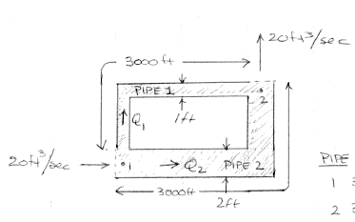
Looped System
Looped system is where one or more pipes rejoin at a different node.

Slide 9
Looped System
Nodes:
Inflow = Outflow
Energy Unique
Links
Head loss along pipe
Head loss in any loop is zero
LOOP

Slide 10
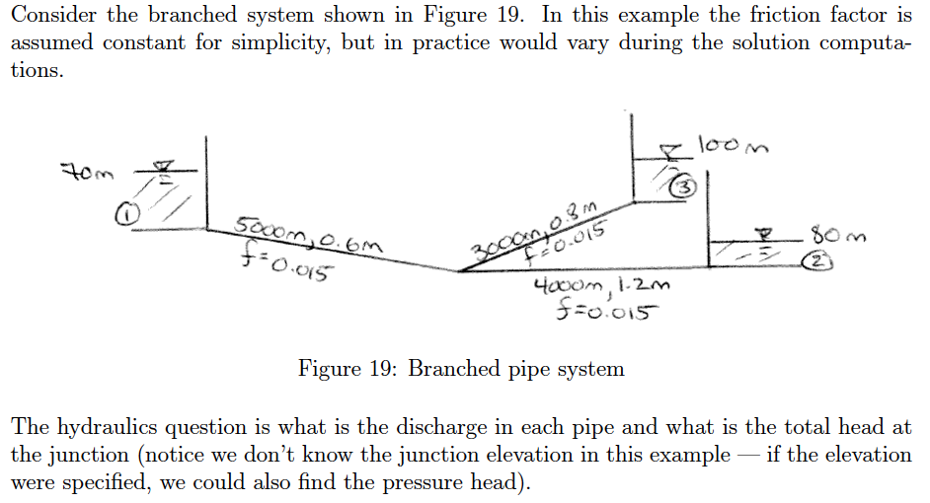
Example – branched system

Slide 11
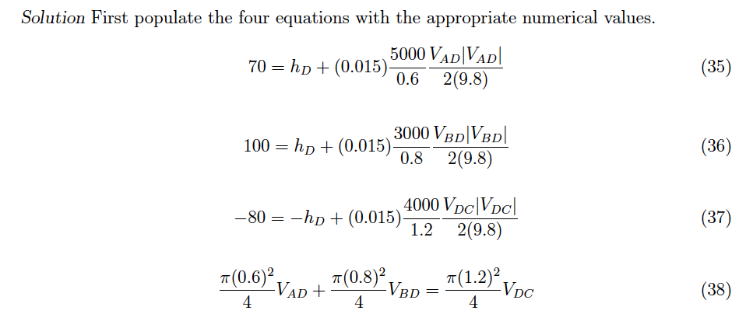
Example – branched system

Slide 12
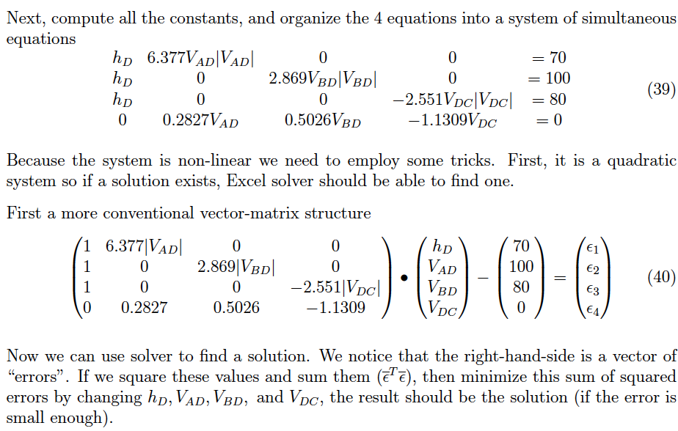
Example – branched system

Slide 13
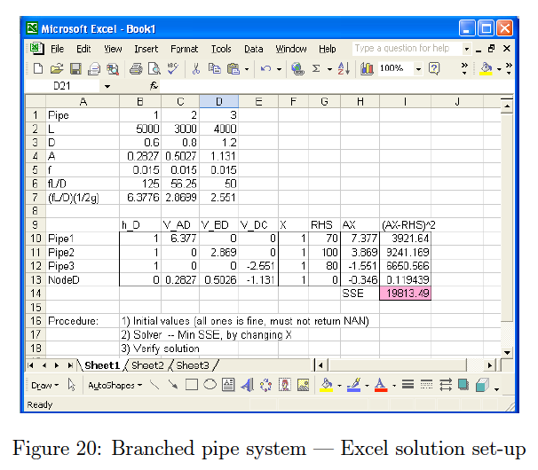
Example – branched system

Slide 14
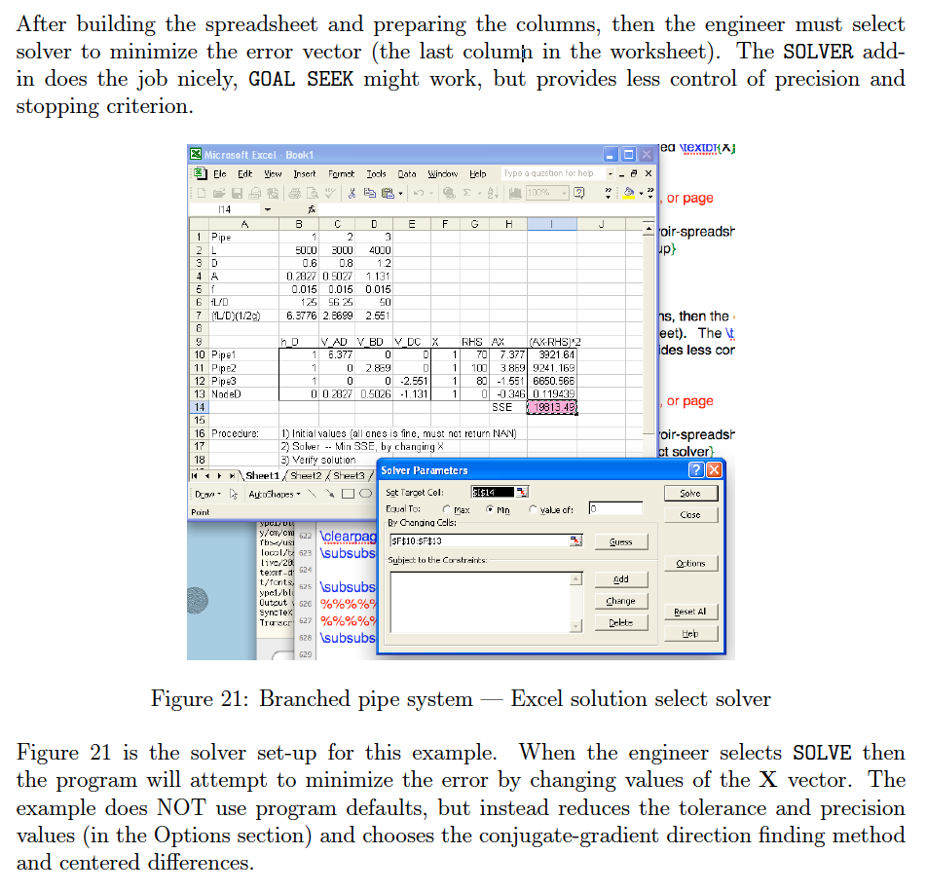
Example – branched system

Slide 15
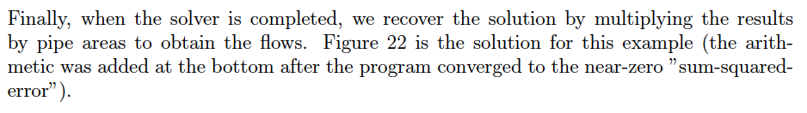
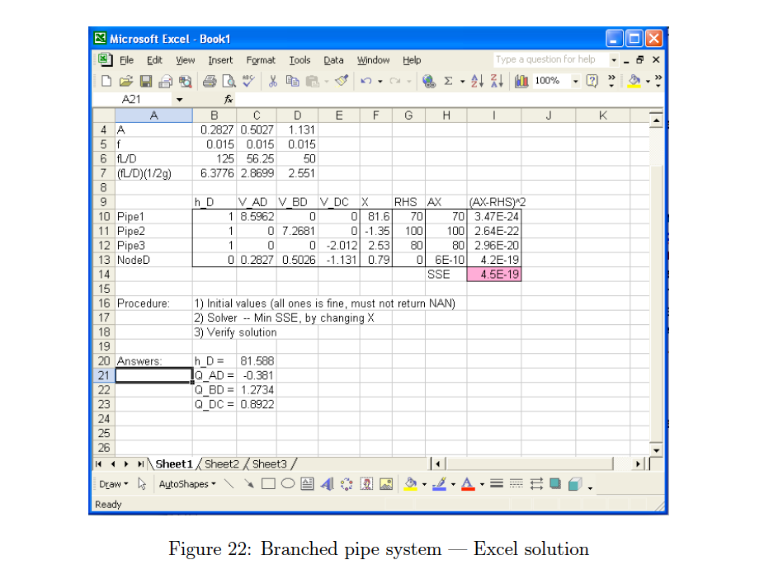
Example – branched system

Slide 16
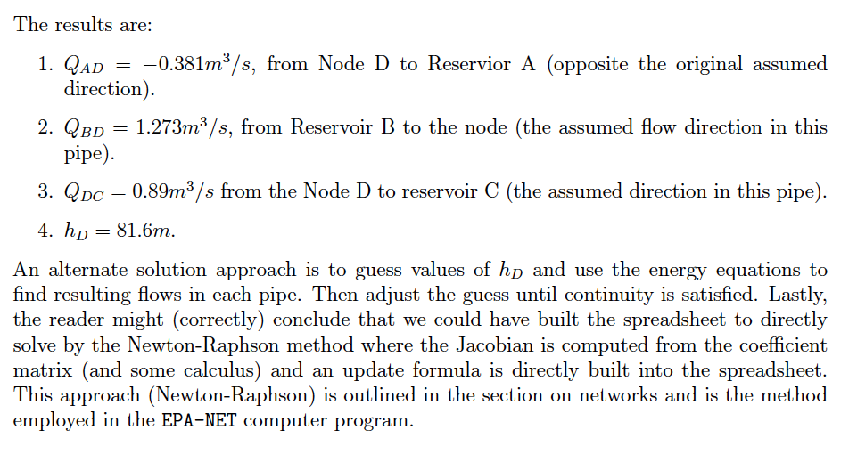
Example – branched system

Slide 17
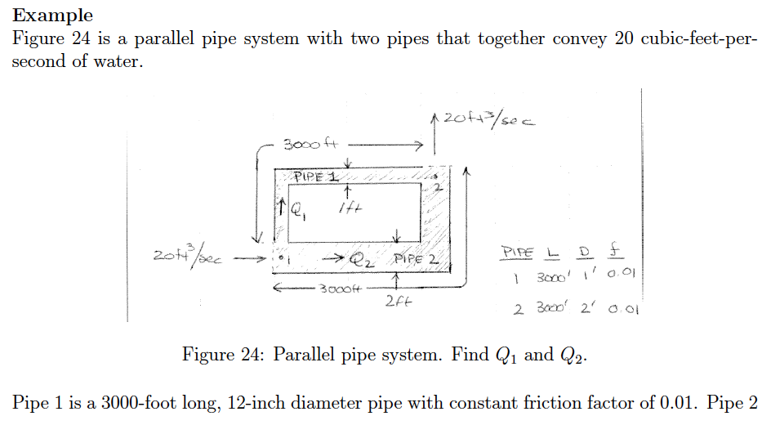
Example – looped system

Slide 18
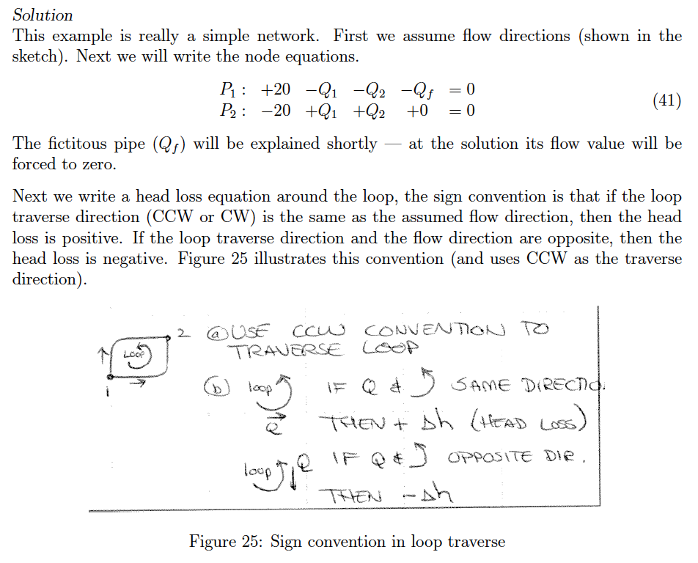
Example – looped system

Slide 19
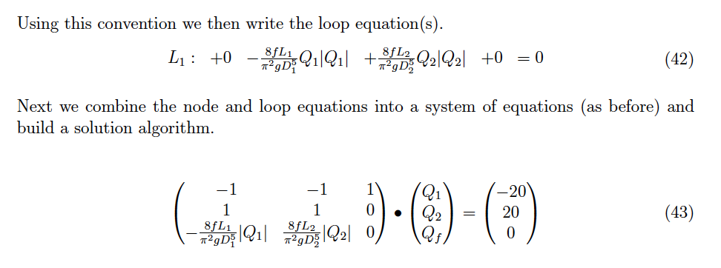
Example – looped system

Slide 20
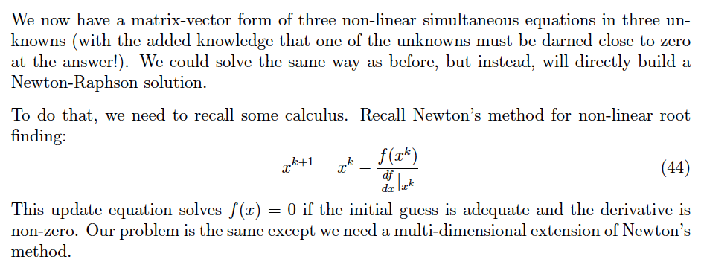
Example – looped system

Slide 21
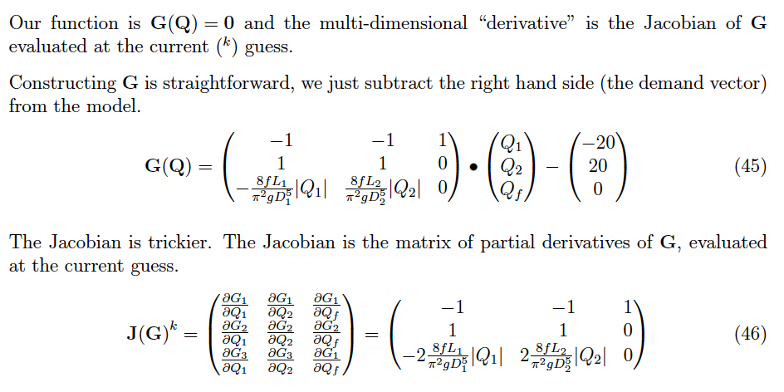
Example – looped system

Slide 22
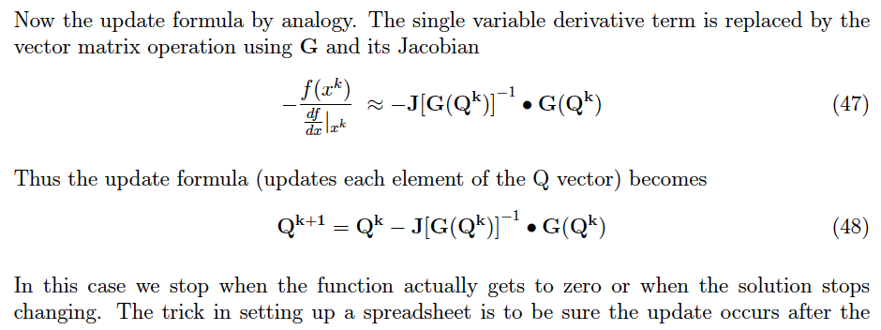
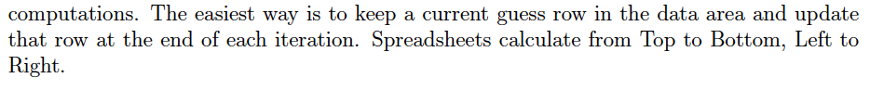
Example – looped system

Slide 23
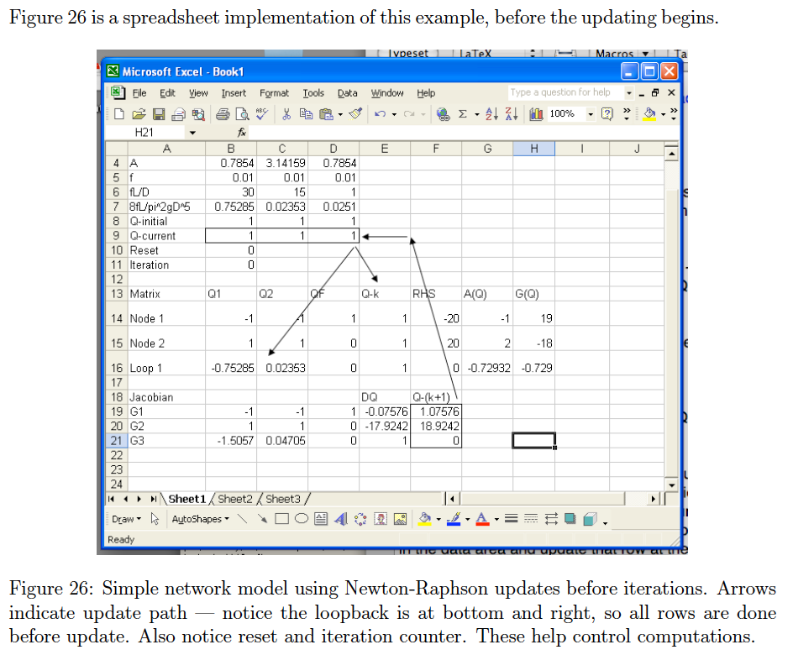
Example – looped system

Slide 24
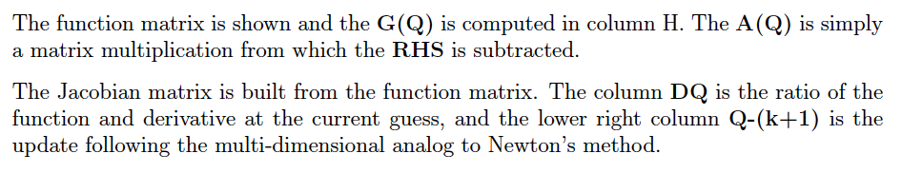
Example – looped system

Slide 25
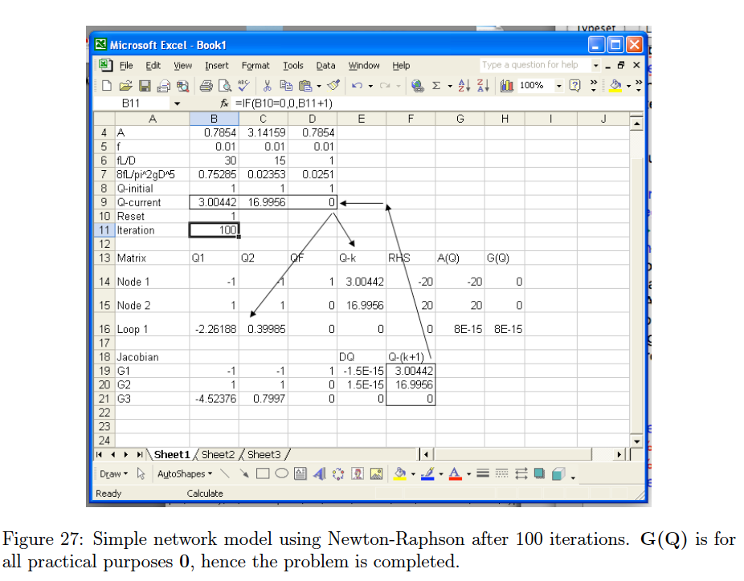
Example – looped system

Slide 26
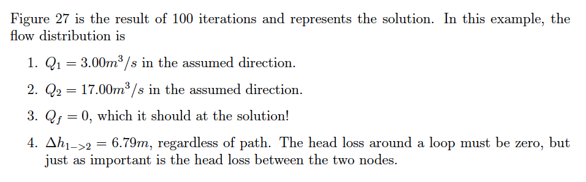
Example – looped system

Slide 27
Networks
Branched and looped systems are called networks
Multiple paths for water to flow in the system
External “demands” are applied at nodes
External “supply” is treated as negative demand

Slide 28
Networks
Analysis techniques
Hardy-Cross (Loop Only Equations)
Newton-Raphson (Node+Loop Equations)
Hybrid Method (Haman and Brameller (1971))(Node+Pipe Equations)
Build node and pipe equations (LIKE THE BRANCH SYSTEM)
Then solve the SIMULTANEOUS non-linear system for flows and heads

Slide 29
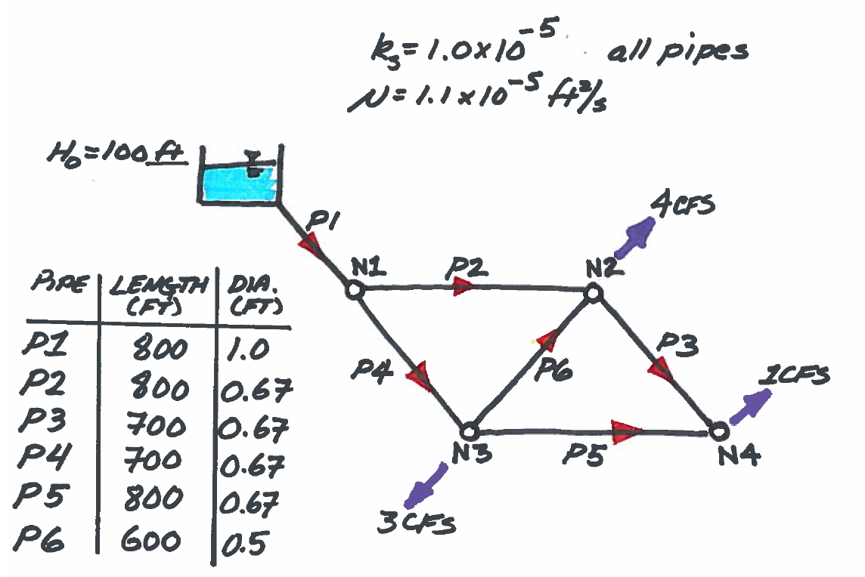
Networks
Consider the system below

Slide 30
Networks
Six pipes
4 nodes + 1 RESERVOIR (Fixed grade node)
Demands shown at nodes
Flow arrows for sign convention

Slide 31
Networks
Continuity is written at nodes (node equations).
Energy loss (gain) is written along links (pipe equations).
The entire set of equations is solved simultaneously.

Slide 32
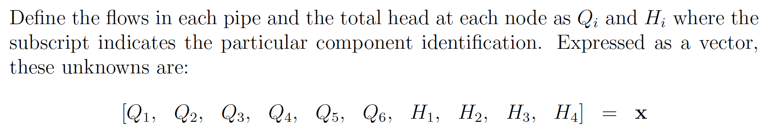
Networks
Define an unknown vector (X)

Slide 33
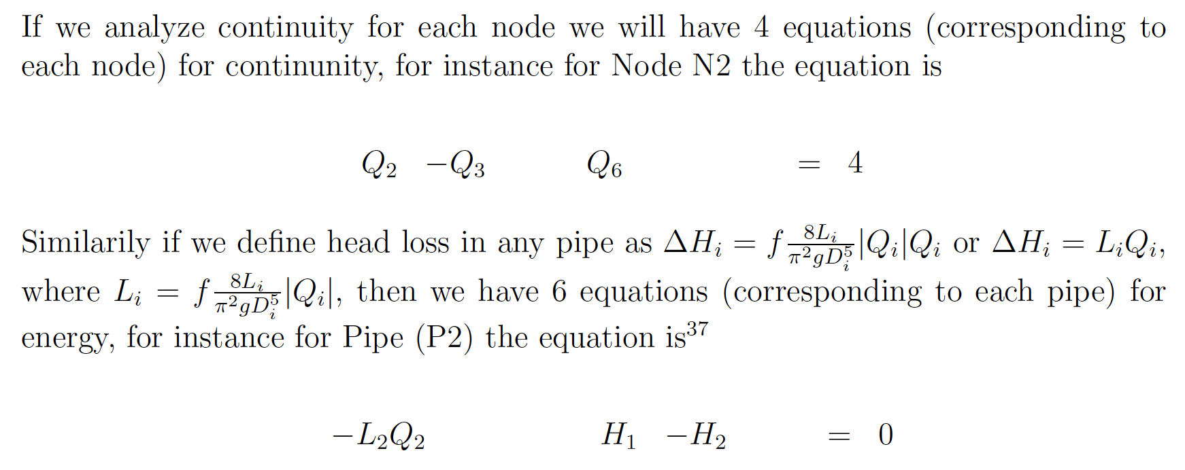
Networks
Build the node and pipe equations

Slide 34
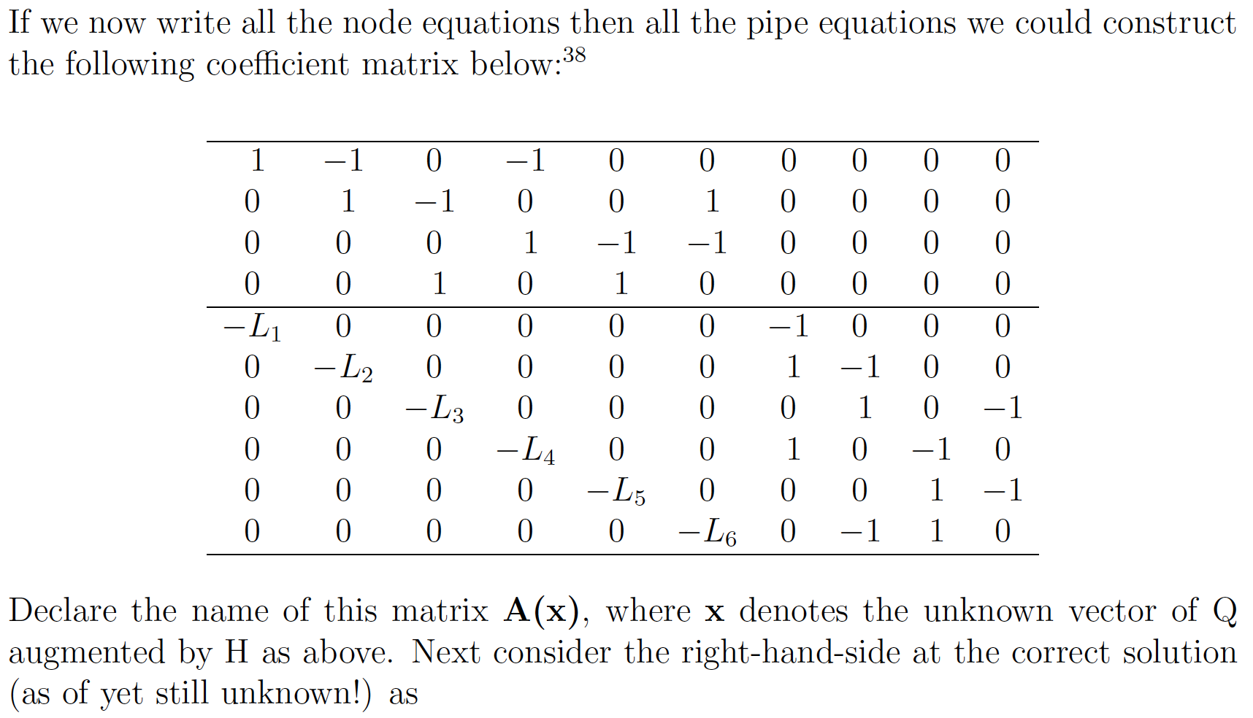
Networks
Build the node and pipe equations

Slide 35
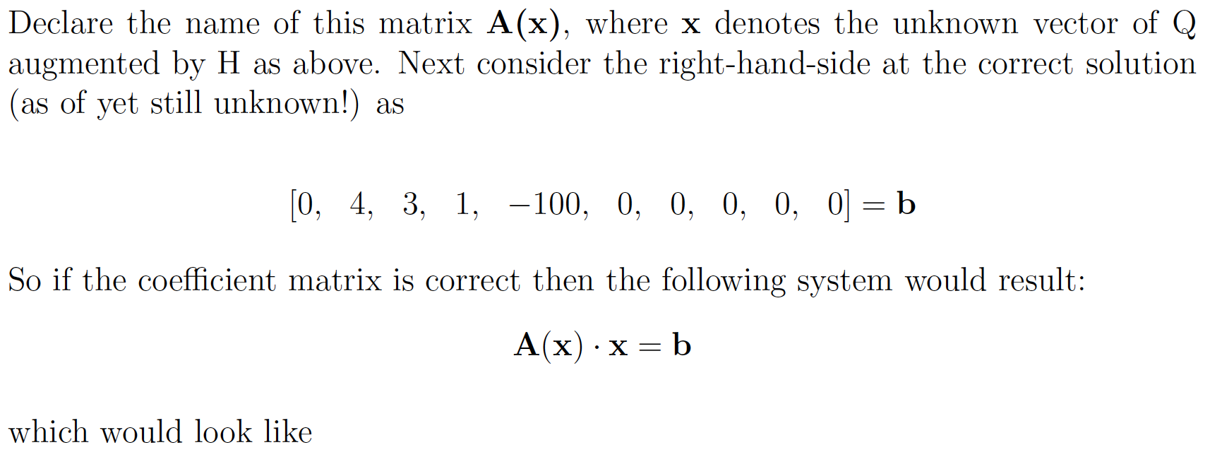
Networks
Build the node and pipe equations

Slide 36
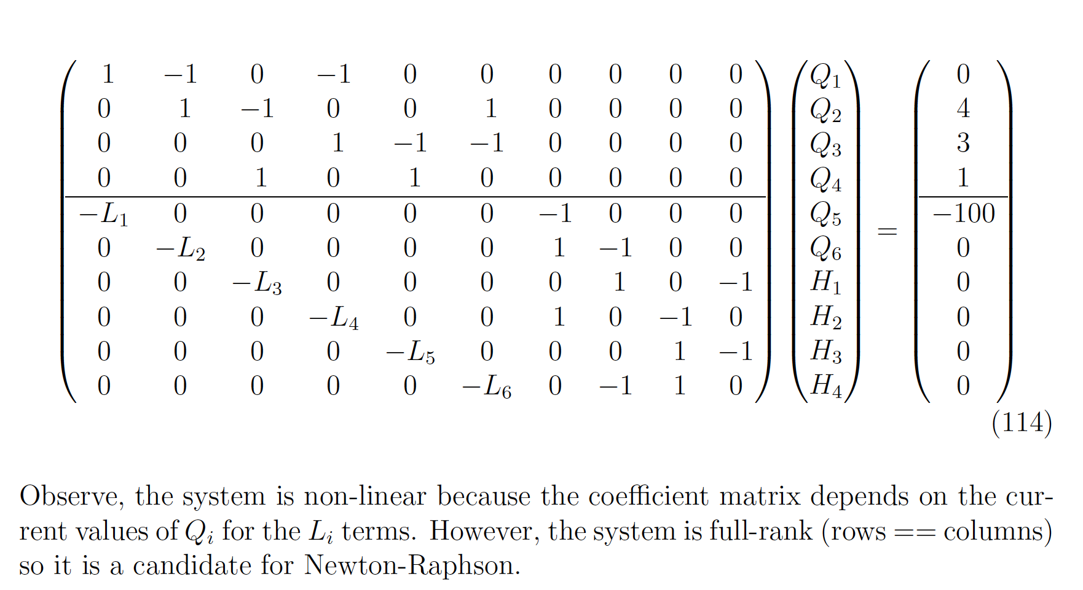
Networks
Build the node and pipe equations

Slide 37
Networks (HYBRID METHOD)
Continuity is written at nodes (node equations).
Energy loss (gain) is written along links (pipe equations).
The entire set of equations is solved simultaneously.

Slide 38
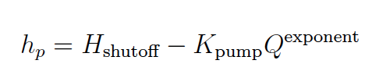
ADDING PUMPS
A pump is treated as a link that adds head in a predetermined flow direction rather than removing head
So it will replace a link equation somewhere in the network model
Typical equation structure is

Slide 39
Network analysis with a pump
Use the prior example as the network, but will replace the supply pipe with a pump and see how that changes the system of equations that need to be solved.

Slide 40
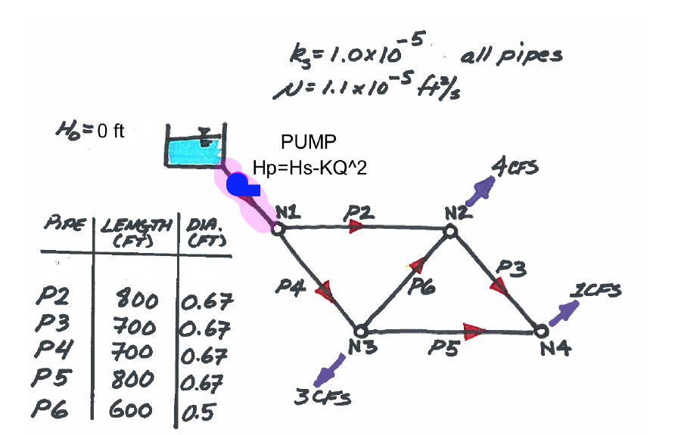
Network analysis with a pump
Pump Curve

Slide 41
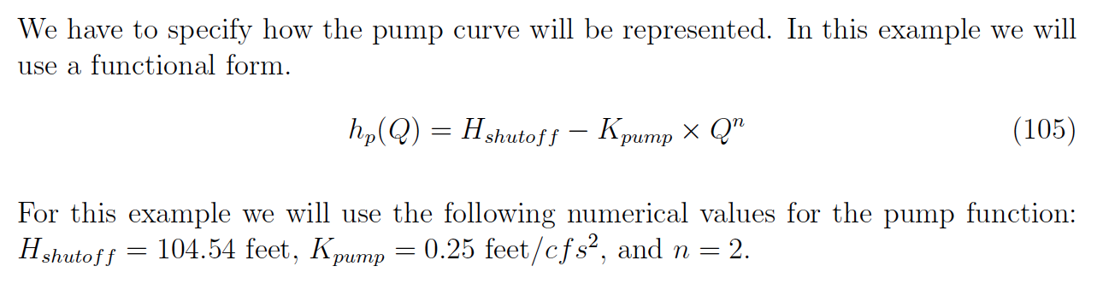
Network analysis with a pump

Slide 42
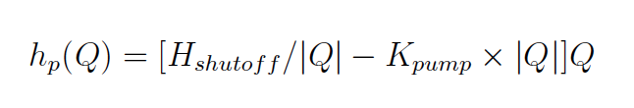
Network analysis with a pump
The actual pump curve function is built in a similar fashion as the loss terms from the previous lesson.
Again sign conveys direction
We should test for the implicit divide-by-zero that can occur as Q=0, and just use the shutoff head at that value

Slide 43
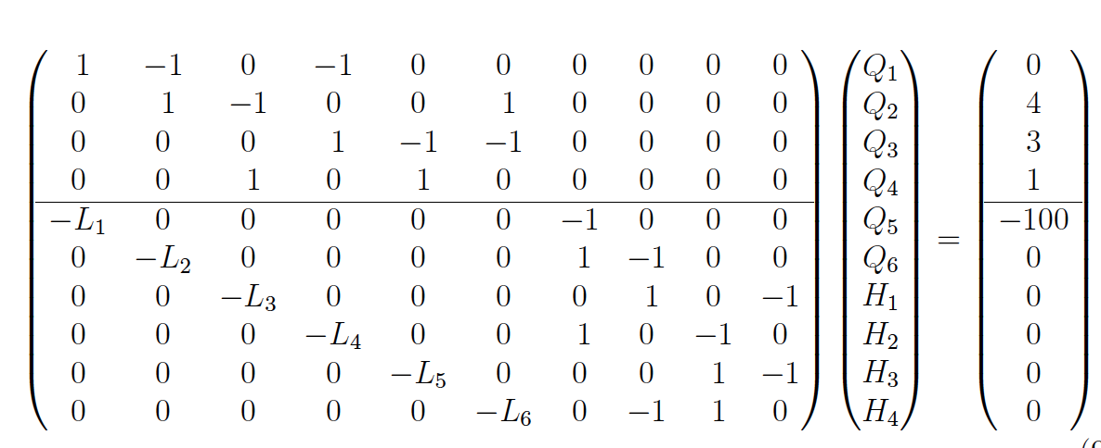
Network analysis with a pump
Here is how the “equations” change : Original Problem

Slide 44
Network analysis with a pump
Here is how the “equations” change : Change Supply Head
-0

Slide 45
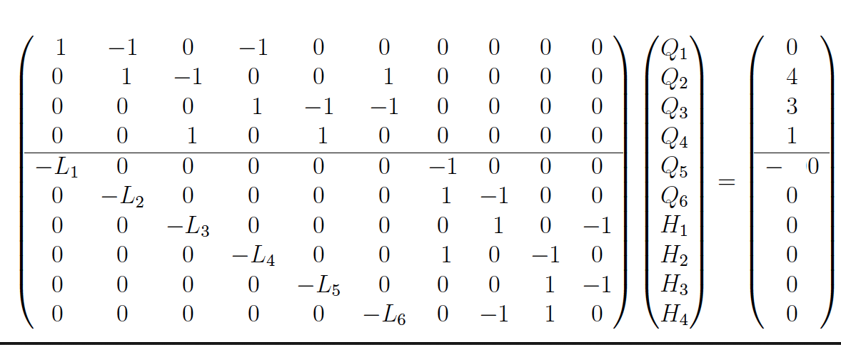
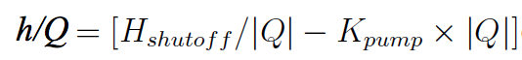
Network analysis with a pump
Here is how the “equations” change : Change Supply Pipe to Pump
Insert Head Function

Slide 46
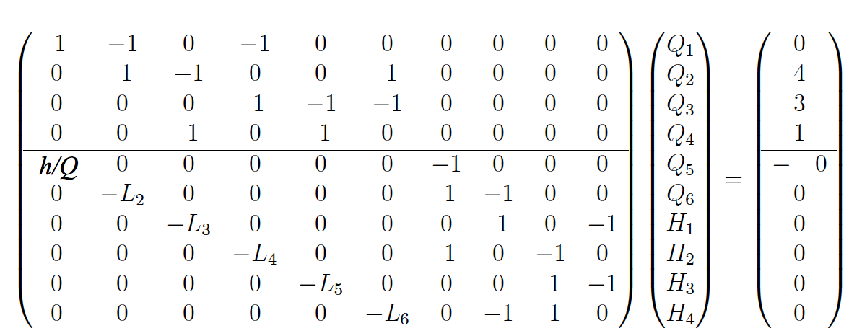
Network analysis with a pump
Here is how the “equations” change : New Model Equations

Slide 47
Network analysis with a pump
Now, encode the new model into a solution tool and proceede.

Slide 48
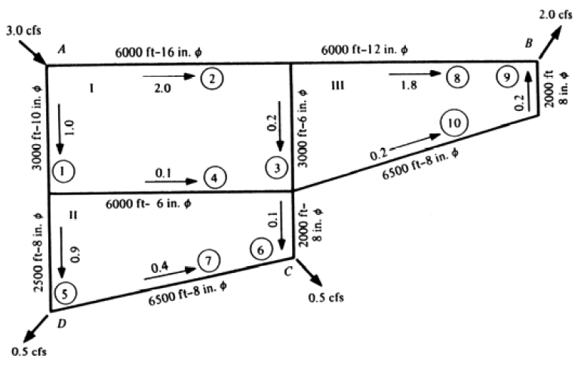
Networks – Why Model?
What is the flow distribution if the demands are changed as shown?
0.1 cfs
0.4 cfs

Slide 49
Network modeling protocol
Sketch the network
Label the nodes, links, supply, and demands
Build the node-arc incidence equations
Continuity at each node
Build the pipe head-loss equations
Head at start node, minus head loss equals head at end node
Build and run a computation tool (spreadsheet)
Make an initial guess of flow rates
Execute the computation tool, update guesses, continue until have flow balance and zero error term

Slide 50
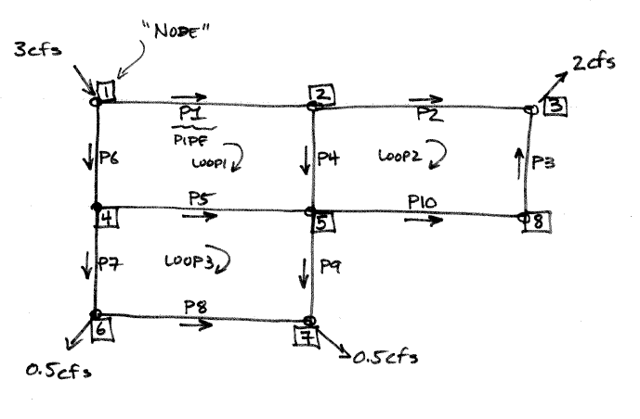
Network modeling protocol

Slide 51
WHAT IF?
Once the tool is built, then “what-if” questions can be posed.
What is the flow distribution if the demands are changed as shown?
0.1 cfs
0.4 cfs

Slide 52
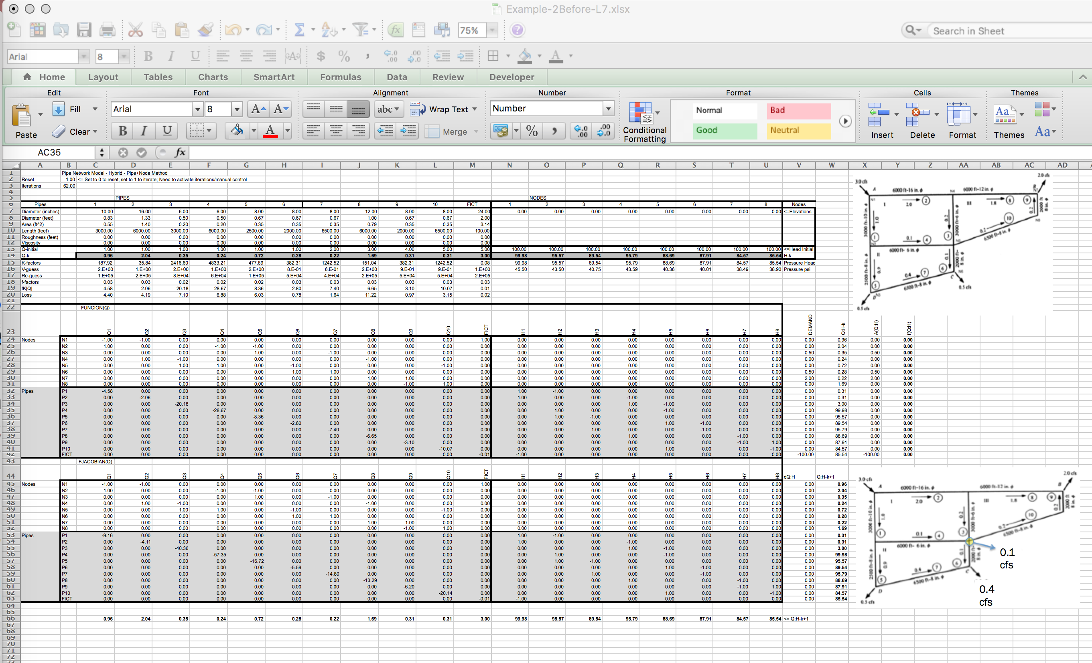
Once the tool is built, then “what-if” questions can be posed.
As the network component count increases, the system of equations get big fast – A really complex problem would be beyond the practical limits of spreadsheet computing (the spreadsheet could do it, it would be hard to construct and maintain)

